Slide 1

The Basics
Click on any rounded button with a cursor to navigate to other pages
O₂ Devices
Cases

Slide 2
Respiratory Physiology
The Basics
O₂ Devices
Cases
Oxygenation
Ventilation
↑ FiO₂
↑ PEEP
x
Tidal volume (V_{t})
Respiratory rate
↑ number or % of O₂ molecules participating in gas exchange (room air is 21% FiO₂)
Recruits additional alveoli during expiration to participate in gas exchange
O₂
O₂
O₂
O₂

Slide 3
Oxygen Delivery Systems
The Basics
O₂ Devices
Cases
Oxygenation
Ventilation
Nasal cannula
Face mask (simple)
↑ max FiO2
Venturi mask
Oxymizer
Non-rebreather mask
100%
High flow nasal cannula
CPAP
BiPAP
PEEP
Mechanical ventilation

Slide 4
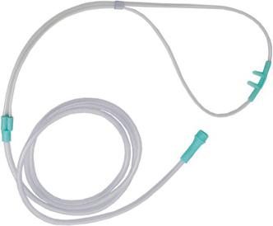
The Basics
Nasal Cannula
O₂ Devices
Cases
15
12
10
8
6
5
4
3
2
1
1
0
100% FiO₂
NC delivers 100% FiO₂ oxygen at designated flow rates
Effective FiO₂
2
ambient air (21% FiO₂)
Effective FiO₂ is dependent on pattern of breathing (minute ventilation, inspiratory flow rate) and patency of nasal passages.
E.g., with increased work of breathing, inspiratory flow rate can be > 100 L/min. This dilutes out the delivered O₂ with ambient air, decreasing effective FiO₂.
Each 1L/min ≈ 3-4% FiO₂ (↓ with ↑work of breathing)
O₂ inspired from the cannula intermixes with ambient air entrained from around the device to create an effective FiO₂
Ideal at 2-4L/min.
Max FiO₂ ~44% at 6 L/min. Higher flow rates do not significantly ↑ FiO₂.
effective FiO₂

Slide 5
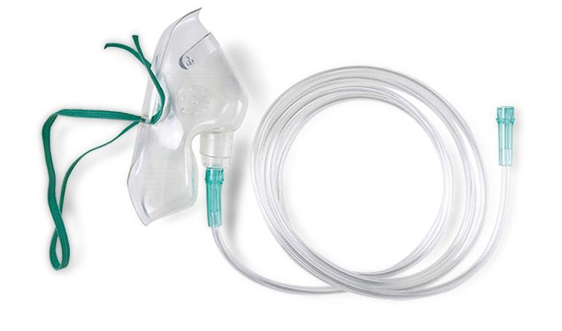
The Basics
Simple Face Mask
O₂ Devices
1
15
Cases
12
10
8
6
O₂ is delivered at various flow rates, which collects in the face mask to create a 100 – 250 mL reservoir of 100% O₂.
5
reservoir
4
3
2
1
0
A reservoir collects 100% O₂ and dilutes out the inspired ambient air. With nasal cannula, the reservoir is our nasopharynx (~50 mL). The larger the reservoir, the less ambient air is entrained with every breath.
2
CO₂
The reservoir ↓ the entrained ambient air with each breath
ambient air (21% FiO₂)
Maximal FiO₂ delivered ~ 60-70% (with normal breathing)
5-6 L/min ≈ 40% FiO₂
6-7 L/min ≈ 50% FiO₂
7-8 L/min ≈ 60% FiO₂
Effective FiO₂
Because of venting holes and poorly fitted masks, ambient air is entrained during inspiration, diluting 100% O₂ delivered to the mask.
3
The mask collects expired CO₂. High flow rates of > 6 L/min are needed to wash out the CO₂ to prevent rebreathing
100% FiO₂
Notes:
Smart, DR. Oxygen Therapy. In: Cameron, P, et al., eds. Textbook of Adult Emergency Medicine. Fourth Edition. 2-15. Churchill Livingstone, Elsevier Ltd.

Slide 6
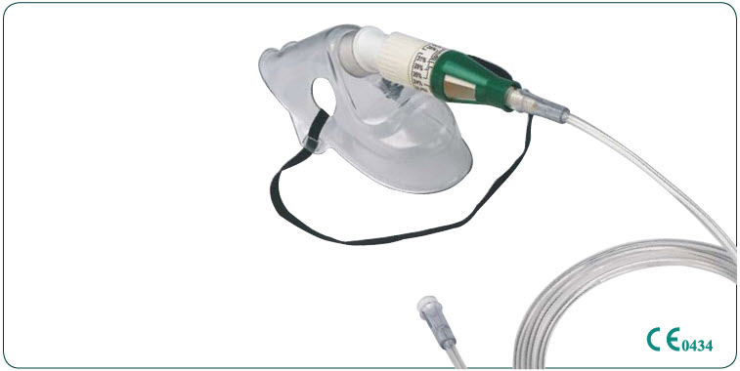
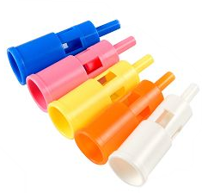
The Basics
Venturi Mask
O₂ Devices
Cases
15
12
10
8
6
5
4
3
2
1
0
2
1
35% FiO₂
CO₂
The Venturi device, entrains ambient air and mixes it with 100% O₂ – delivering a fixed flow rate and FiO₂ to the mask.
35
Higher desired FiO₂ requires lower flow rates
Desired 35% FiO₂ → ~45 L/min
Desired 60% FiO₂ → ~ 30 L/min flow
Venturi device
ambient air (21% FiO₂)
Maximum FiO₂ of ~60% with flow rates up to 60 L/min
100% FiO₂
Useful for providing set FiO₂ to patients with a variable breathing pattern

Slide 7
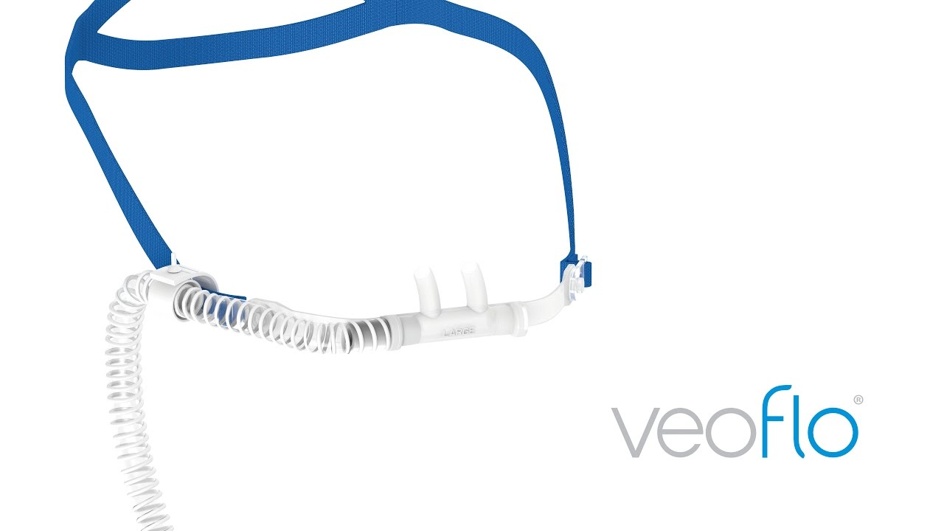
The Basics
High Flow Nasal Cannula
O₂ Devices
60
Cases
50
40
FiO₂(%)
30
1
20
60
40
10
80
20
0
100
0
Thicker nasal cannula prongs, which occlude the nasal passages, combined with the high flow rates, generate small amounts of PEEP (~ 3-5 cm H₂O).
2
PEEP
PEEP
Thick nasal cannula prongs
Humidifier
Adjustable FiO₂ and flow rate.
Maximum flow rate is ~ 60 L/min and maximum effective FiO₂ is near 100%.
High flow rates of O₂ wash out the nasopharynx and upper airways with the delivered O₂, creating an oxygen reservoir. This also ↓ CO₂ rebreathing and dead space.
Trachea
3
Higher flow rates delivered are able to match higher inspiratory flow rates in patients with ↑ work of breathing and minute ventilation.
Set FiO₂

Slide 8
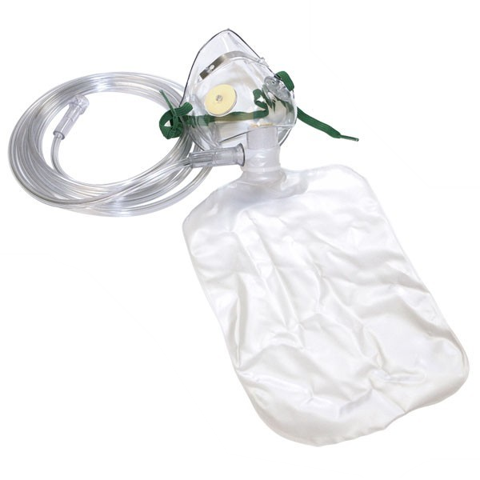
The Basics
Non-rebreather Mask
O₂ Devices
15
12
10
8
Cases
A one-way inhalation valve between the mask and reservoir bag allows O₂ to flow from the tubing → reservoir bag → mask but does not allow exhaled CO₂ to re-enter the bag.
One-way exhalation valves let out exhaled CO₂.
6
5
4
3
2
1
0
ambient air (21% FiO₂)
One way valve
(exhalation)
2
One way valve
(inhalation)
One-way valves control the flow of O₂ and CO₂ to allow the patient to preferentially breathe 100% FiO₂ from the reservoir bag and expel CO₂ into the environment.
CO₂
1
3
A reservoir bag that varies from 600 mL – 1.5 L. The bag must be inflated to create a reservoir! Flow rates of >10 L/min are required to fill the bag.
100% FiO₂
Maximum effective FiO₂ of 75 – 90% at flow rates of 12 – 15 L/min.
Reservoir bag
Rescue form of oxygen only!!

Slide 9
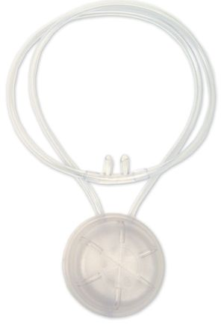
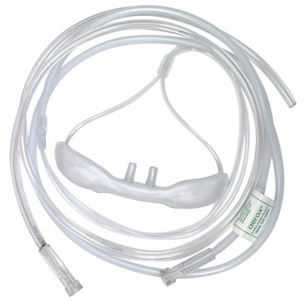
The Basics
Oxymizer
O₂ Devices
15
Cases
12
10
8
6
reservoir
5
4
3
2
1
0
A reservoir collects 100% O₂ and dilutes out the inspired ambient air. With nasal cannula, the reservoir is our nasopharynx (~50 mL). The larger the reservoir, the less ambient air is entrained with every breath.
1
Oxymizer reservoir
The additional reservoir allows ↑ flow rates to be delivered more comfortably and ↑ effective FiO₂ for the same flow rate as compared to nasal cannula.
Max flow rates reported at 20 L/min, but in practice, ~12-15 L/min
ambient air (21% FiO₂)
100% FiO₂
Oxymizers contain an additional 20 mL reservoir in a pendant or mustache“ shape.
2
Effective FiO₂ is affected by work of breathing
Max FiO₂ reported is > 80%, but in practice, likely lower
*maximum values noted are reported from manufacturing details
Dumont, CP & Tiep, BL. 2002. Using a Reservoir Nasal Cannula in Acute Care. Critical Care Nurse. 22(4): 41-46.
Tiep, BL & Belman, MJ. 1985, A new Pendant Storage Oxygen-conserving Nasal Cannula. CHEST. 87: 381-383.

Slide 10
The Basics
Noninvasive Positive Pressure Ventilation
O₂ Devices
Allows for titration of both FiO₂ and PEEP
NIPPV Effects
IPAP recruits additional alveoli during inspiration → ↑ V_{t}
CPAP
BiPAP
Indications
inspiration
Cases
IPAP
The greater the difference between IPAP and EPAP (or ΔPAP), the greater the V_{t}
Pressure
Pressure
expiration
EPAP
Constant pressure through inspiration and expiration (aka PEEP)
EPAP is PEEP.
↑EPAP = ↑ PEEP.
time
time
Affects oxygenation (PEEP)
Affects oxygenation (PEEP) and ventilation (tidal volume)

Slide 11
The Basics
Noninvasive Positive Pressure Ventilation
Physiologic Effects
O₂ Devices
NIPPV Effects
THORAX
2
↓ LV preload
Indications
↑ intrathoracic P → ↑ resistance of blood flow out of the RV (≈ ↑ in RV afterload) → ↓ blood flow to L side of the heart
Cases
↑ Pressure
LV
↑ Pressure
RV
1
3
↓ LV afterload
↓ RV preload
↑ intrathoracic P → pressure gradient between thoracic and abdominal aorta → ↓ effort required by LV to eject blood out of the heart
↑ intrathoracic P → ↑ resistance to venous return to the R heart
ABDOMEN

Slide 12
The Basics
Noninvasive Positive Pressure Ventilation
Indications in acute respiratory failure
O₂ Devices
NIPPV Effects
CPAP
BiPAP
Indications
Cases
Acute cardiogenic pulmonary edema
COPD exacerbation with hypercapnic respiratory failure
ACUTE
RESPIRATORY FAILURE
Immunocompromised patients
Post-operative respiratory failure
Post-extubation respiratory failure
Palliative
OSA/ OHS
CHRONIC
Neuromuscular disease
Contra-indications
Inability to wear a mask (facial trauma)
Active nausea/vomiting, copious secretions
Inability to pull off a mask (AMS, paralysis)
Recent esophageal or tracheal surgery

Slide 13

The Basics
Case 1
Case 2
Case 3
O₂ Devices
64 yo with R sided renal cell carcinoma present for a R nephrectomy. On POD5, they develop acute onset SOB.
VS: T 37.1C, HR 140, BP 90/60, RR 28, SaO₂ 82% on RA.
74 yo with a history of COPD presents with a COPD exacerbation.
VS: T 37.1C, HR 120, BP 160/60, RR 32, SaO₂ 82% on RA.
PE: Sleepy but easily arouses. Diffuse wheezing.
CXR is clear. ABG shows 7.21/72/45/28.
56 yo with HFrEF is admitted with a HFrEF exacerbation. CXR shows diffuse bilateral alveolar infiltrates.
VS: T 36.5C, HR 110, BP 160/80, RR 32, SaO2 75% on RA.
Cases
Given severity of hypoxemia, consider a non-rebreather to quickly improve oxygenation.
Trial of nasal cannula can be used for mild-moderate hypoxemia
How would you improve their SaO_{2?}
How would you improve their SaO₂?
How would you improve their SaO₂?
BiPAP is needed for hypoxemic and hypercarbic respiratory failure.
They progressively desaturate and are now on 6L NC with SaO₂ 89%.
They are placed on BiPAP of 10/5, 35% FiO₂. Repeat ABG shows 7.30/60/79/28.
On non-rebreather, SaO₂ improves to 89%, RR is now 28. ABG shows 7.46/29/59/24.
They can be escalated to an oxymizer, Venturi mask or HFNC
How would you improve their SaO₂?
Increase the IPAP. There is persistent hypercarbic respiratory failure. To improve ventilation, ↑ the ΔPAP.
How would you adjust their BiPAP settings?
Start CPAP. They have persistent hypoxemia despite near max FiO_{2.} Additionally, acute cardiogenic pulmonary edema is a strong indication for NIPPV.
What is your next step in management?
On POD7, they are on HFNC 100% FiO₂, 60 L/min. RR is 24 and shallow, SaO₂ 86%. They are obtunded and difficult to arouse. ABG shows 7.21/72/45/20.
There is persistent hypoxemia (PaO₂ 55) but respiratory acidosis/ hypercapnia is resolved (7.35/45). Hypoxemia can be addressed by ↑ FiO₂ or EPAP/IPAP proportionately (e.g., 12/7)
What if the ABG showed 7.35/45/55/28?
Intubation and mechanical ventilation. There is hypoxemic and hypercarbic respiratory failure despite max FiO₂. PEEP is needed to ↑ PaO₂. BiPAP is contraindicated with AMS. Other contraindications to NIPPV: facial trauma, copious secretions, nausea/vomiting, hemodynamic instability.
What is your next step in management?
What if the ABG showed 7.30/60/55/28?
There is persistent hypoxemia (PaO₂ 55) and hypercapnia (7.30/60). Options include:
↑ IPAP alone + ↑ FiO₂. E.g. 12/5, 50% FiO₂
Or ↑ EPAP and ΔPAP. E.g., 15/7.

Slide 14
MAXIMUM FiO₂ AND FLOW RATES FOR OXYGEN DELIVERY DEVICES
100%
HIGH FLOW NASAL CANNULA
NON-REBREATHER MASK
80%
OXYMIZER
Maximum FiO₂
SIMPLE FACE MASK
60%
VENTURI MASK
40%
NASAL CANNULA
2
4
6
10
20
40
0
8
60
80
Range of Flow Rates (L/min)

Slide 15
Oxygen Delivery — 2022–25 Context Update
The device physiology, NIPPV mechanics, and indications are timeless and verified current (June 2026). The items below add modern evidence; standing teaching unchanged.
HFNC first-line for acute hypoxemic respiratory failure: ESICM ARDS 2023 recommends HFNC over conventional oxygen in non-intubated AHRF to reduce intubation — EXCEPT cardiogenic pulmonary edema and COPD exacerbation, where NIPPV (CPAP/BiPAP) is preferred. Consistent with FLORALI (Frat, NEJM 2015).
Monitor HFNC with the ROX index = (SpO2/FiO2) ÷ RR. ROX ≥4.88 at 2/6/12 h predicts HFNC success; a low or falling ROX flags impending failure — escalate, do not delay intubation (Roca, AJRCCM 2019).
Awake prone positioning is a recommended adjunct for non-intubated patients with COVID-related hypoxemic AHRF on HFNC/NIPPV — reduces intubation (strong rec, 2023 rapid practice guideline); trial 15 min, continue if tolerated.
CPAP vs HFNC in COVID AHRF (RECOVERY-RS, JAMA 2022): CPAP reduced the intubation/death composite vs conventional oxygen; HFNC did not differ. HFNC and NIV are otherwise similarly effective at avoiding intubation in AHRF (2023 meta-analysis).

Slide 16
Take-Home Points
1. Hypoxemia is corrected by raising FiO2 or adding PEEP. Most ward devices (nasal cannula, simple/Venturi/NRB masks, oxymizer) adjust only FiO2; effective FiO2 falls as work of breathing/inspiratory flow rises.
2. HFNC delivers high, matched flow with finely titratable FiO2 (up to ~100%) and a small, non-adjustable PEEP (~3-5 cm H2O); it improves oxygenation, work of breathing, and minute ventilation.
3. NRB is a RESCUE device only — de-escalate once stable. Venturi gives a precise set FiO2 for variable breathing patterns.
4. CPAP = oxygenation only (PEEP). BiPAP (IPAP−EPAP = ΔPAP) adds ventilation → use for hypercapnic failure. Both unload the heart (↓ RV/LV preload, ↓ LV afterload) — strong in acute cardiogenic pulmonary edema; BiPAP for COPD hypercapnic failure.
5. First-line for AHRF is HFNC (except cardiogenic edema and COPD); add awake proning; track the ROX index and escalate early.

Slide 17
Attribution & Optimization Notes
Original lesson: “Oxygen Delivery Systems,” TeachIM.org (updated Oct 2021).
Author: Yilin Zhang MD (Valley Medical Center).
Source URL: teachim.org/teaching_material/oxygen-delivery-systems/
License: Creative Commons Attribution-NonCommercial 4.0 International (CC BY-NC 4.0). Non-commercial educational use only.
Corrections made (this edit, all single-run XML, animations preserved): (1) HFNC slide PEEP unit "3-5 mm H2O" -> "3-5 cm H2O" (airway pressures are cm H2O); (2) Case 3 spelling "non-rebreathrer" -> "non-rebreather"; (3) Oxymizer citation page range "381=383" -> "381-383".
Context added (source-cited): ESICM ARDS 2023 (HFNC first-line for AHRF); ROX index (Roca AJRCCM 2019); awake-proning 2023 rapid practice guideline; RECOVERY-RS (JAMA 2022). FLORALI/Hernandez already cited on deck.
No companion handout is published for this lesson (single interactive board). Medical content should be clinician-reviewed before teaching.

